Slide 1

An Android Hacker's Journey
Challenges in Android Security Research
Joshua J. Drake CanSecWest March 7th 2013

Slide 2
Overview
About Josh
Goals
Survey
Background
Ecosystem
Patching
Disclosure
Attack Surface
Tools
Exploitation
Hardening
Recommendations
Conclusions
Notes:
This is what we’re going to cover in the next 45 minutes or so…
Although I won’t be covering much regarding Apps, I’ll do my best to answer any questions you might have. This is not my focus area.

Slide 3


About
Joshua J. Drake, aka jduck
Research Practice Manager (Science Lord)
Former Lead Exploit Developer at
Researching Linux security since 1994 (1.1.59)
Researching Android security since Droid 1 (2009)
Consulted for a major Android device OEM
Teamed up with Georg Wicherski to exploit Android browser for BlackHat USA 2012
Lead author of “Android Hacker’s Handbook”
Notes:
Binary/Source Audit, Reverse Engineering
Vulnerability Discovery & Exploitation
Currently focused heavily on Android research and authoring the book.

Slide 4
Goals / Motivations
Improve Android security
Improve security awareness
Provide motivation ;-)
Enable other researchers to do their thing
Summarize information from many sources
Improve the tool-chain
Notes:
Improve security awareness
Point out weaknesses when discovered
Spread the word about weaknesses
Provide “motivation” to parties involved in the ecosystem

Slide 5

Survey
Notes:
I’d like to ask a few questions. Please don’t be shy, please answer.
Your answers won’t be shared outside this room, but they will guide how I proceed with the rest of the talk.
It will also help me spot like-minded people to chat up later ☺
How many people here don’t know what Android is?
How many people have at least one Android device?
How many people have more than one?
More than 5? 10? …?

Slide 6
Background
Notes:
So let’s go over some Android background…
Skip slides based on survey results

Slide 7
Introduction
Smartphone operating system
Open Source (mostly)
Linux based
Notes:
Android is currently the most popular smartphone operating system on the planet.
Although it is often touted as being open source, this is not entirely true. More on that in a bit.
It’s based on a modified version of the Linux kernel.

Slide 8
Early History
Founded in 2003
Acquired by Google in 2005
Released publicly in 2008 (HTC G1/Dream)
~ 33 releases so far
http://en.wikipedia.org/wiki/Android_version_history
http://socialcompare.com/en/comparison/android-versions-comparison
Notes:
Founded by Andy Rubin, Rich Miner, Nick Sears, and Chris White
It’s pretty interesting how long it took from being founded to first release.

Slide 9
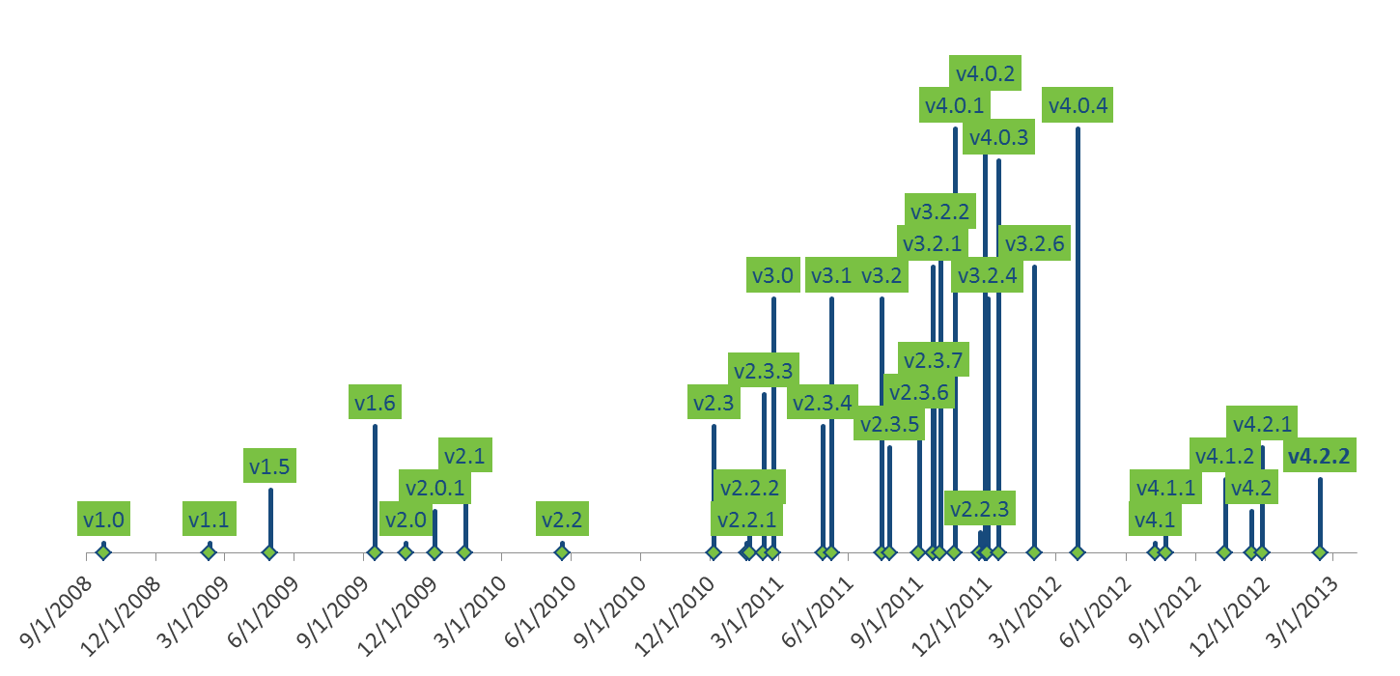
Version History
Ice Cream Sandwich
Honeycomb
Gingerbread
Donut
Jelly Bean
Cupcake
Éclair
Froyo
Notes:
This information is from Wikipedia - http://en.wikipedia.org/wiki/Android_version_history
Another great reference is - http://www.theverge.com/2011/12/7/2585779/android-history
I’m not going to read through all this, but there are couple of important things to draw from this.
First, although Android is soon celebrating its fifth birthday, it’s really only been available for a little over 4 years.
Second, the current version is 4.2.2 – Jelly Bean. It represents the culmination of development since inception.
32 releases so far

Slide 10
Supported Architectures
Android supports at least 4 architectures
ARM
The Lion’s share of devices out there…
x86
Google TV devices, tablets, phones
MIPS
PowerPC
Really anything Linux will run on…
Notes:
Raise your hand if you have a MIPS, PowerPC or SuperH device…

Slide 11
Ecosystem
It’s complicated…

Slide 12
Ecosystem
Understanding the Ecosystem is important
Provides perspective
Good to know who is responsible for what
Makes the complexities involved evident
Put yourself in their shoes…
Helps you put your palm on your face

Slide 13
Ecosystem Groups Part I
Six main groups
Google
Hardware fabricators
Original Equipment Manufacturers (OEMs)
Carriers
…
Notes:
All of these groups serve a particular purpose in the ecosystem.
Google develops the core operating system, including the dalvik virtual machine that runs apps.
Hardware fabricators make the underlying hardware devices, which all need drivers to function.
OEMs make the devices for consumers. They handle integration and often customize the OS for brand loyalty or differentation.
Carriers primarily provide voice and data access for devices. In addition, they add custom apps, services, and so on.

Slide 14
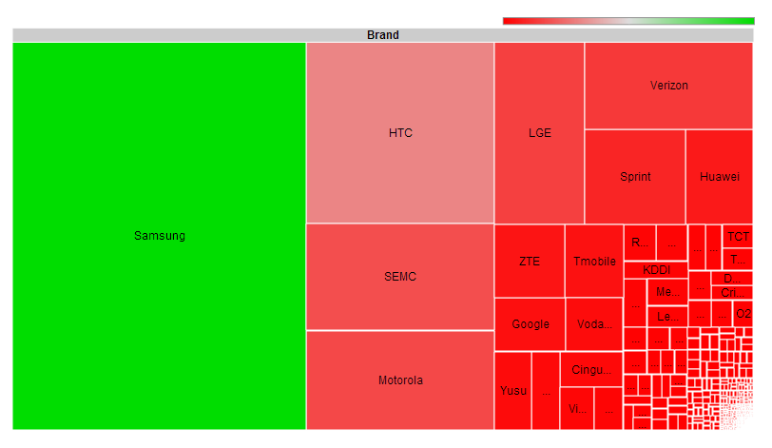
Ecosystem: OEMs / Carriers
http://opensignal.com/reports/fragmentation.php
Notes:
The color shows the number of devices for that particular OEM or carrier…
This is a bit dated, from August 2012.

Slide 15
Ecosystem Groups Part II
…Six main groups
Third party developers
Custom ROMs, freelancers, upstream projects, etc
Users
All of them
Are inter-dependent to varying degrees
Could impact the security of a given device
Notes:
Developers outside of the first four groups typically create apps, but they could also contribute patches.
Additionally, there are quite a few open source projects being used in Android.
People working on those projects also fall into this group.
Users are the people that keep the ecosystem alive, the consumers. They mostly just want devices that make their lives easier.
All of these groups depend on each to varying degrees to keep the ecosystem alive and well.
Due to the open source nature of Android, all of these groups have the potential to impact the security of a particular device.

Slide 16
Open Handset Alliance (OHA)
OHA
Founded in 2007
Mission: increased openness
Compared to mobile ecosystem before Android?
Members Android builds must be “Android Compatible”
Currently includes most vendors working with Android
Notes:
Founded in 2007 (just prior to first public release)
The alliance states they are for increased openness
Members are not allowed to released Android builds that are not “Android Compatible”
(more about this in a bit)
The open handset alliance currently includes pretty much all of the major Android vendors

Slide 17
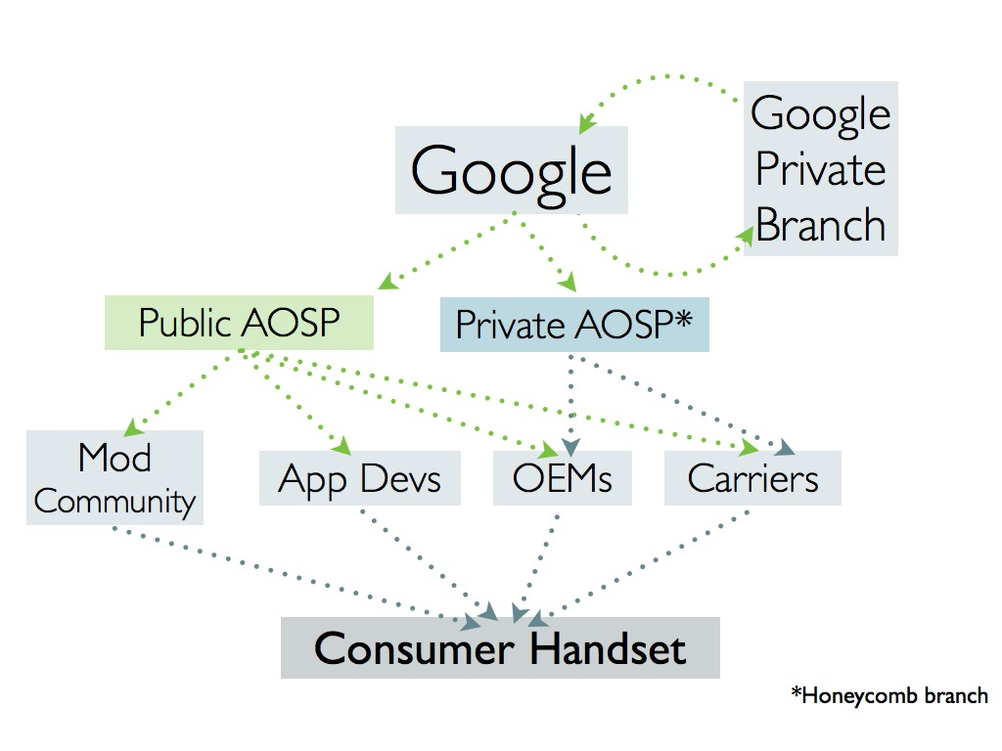
Ecosystem: Map
https://blog.lookout.com/blog/2011/08/04/inside-the-android-security-patch-lifecycle/
Notes:
Graph from Lookout Mobile security, shows the general who-develops-what graph.
Missing some pieces about hardware fabricators, which would fit roughly where the blue “Private AOSP” box is..
Although that box says Honeycomb is private, the source was released sometime after this graphic was made.
Hardware people make the platform
Kernel drivers, architecture support code
Google makes the base OS and Framework
OEMs change everything
Carriers complicate the situation and add bloat
Third-party OS and Applications

Slide 18
Ecosystem: Summary
Massive cross-organizational Bureaucracy
Everyone working with different goals
Some goals are competing or conflicting
Notes:
OEMs want to make changes, Google wants a PURE experience.
Users want secure and safe devices, carriers want very long test cycles.
Etc.
I’m frankly amazed that they’ve gotten this far.

Slide 19
Ecosystem: Take-aways
Provides a rich area for security research
Implicit trust between groups
Source code complexities
Creates “half-day” exploit risk
Ex: WebKit bugs fixed in Chrome but not Android
See Michel Aubizzierre’s Infiltrate 2012 talk!
Lengthens patch cycle
Leaves end-users unprotected
Notes:
Does anyone not know what the “half-day” term means?
The term is rooted in “half-life” from radioactive materials. That is, you could consider such a bug decaying.
Researchers use this term to describe bugs that have a fix, but the fix has not fully propagated yet.

Slide 20
Patching
What patching?

Slide 21
Patching: AUA
Android Update Alliance
Required support for 18mo
But cellular contracts are 24mo!!!
Announced, but never mentioned again…
Who is even part of it?!
Nobody knows… Seemingly no one.

Slide 22
Update Sources
Updates for different pieces come from different places
Apps
Authors->Play Store->User
OS (via OTA)
Google->OEM->Carrier->User
Straight from Google for Nexus devices

Slide 23
Update Formats
No package manager
Monolithic firmware images
One per partition usually
Often more than 10 partitions
May contain proprietary contents
dq:0:~/android/dev/cluster$ ./1cmd.rb gn-takju find /dev/block/platform -name by-name -exec ls -l \{\} \\\; | wc -l
14
dq:0:~/android/dev/cluster$ ./1cmd.rb sgs3 find /dev/block/platform -name by-name -exec ls -l \{\} \\\; | wc -l
23

Slide 24
Patching: CTS
Android Compatibility Test Suite (CTS)
Google’s “Android Compatible” stamp of approval
Used to enforce security baselines
No known vulnerabilities
No world writable directories
etc
Continually Evolving
Tests are open source (Contribute!)
http://blog.n0where.org/errata-to-avoiding-android-app-security-pitfa
https://blog.lookout.com/blog/2011/08/04/inside-the-android-security-patch-lifecycle/

Slide 25
Time to Patch
Google – Days or weeks
OEMs – Not enough information available
Seems to be getting better recently!
Carriers – Months or never
Notes:
Patching is still horrible despite, or maybe because of, CTS.
Would be great to see some data on this, so fingers can be pointed in the right direction ☺

Slide 26
Patching: Summary
Little-to-no back-porting fixes
Again, exploits for “half-day” bugs
Users left vulnerable indefinitely

Slide 27
Disclosure
Does this happen?

Slide 28
Why disclose?
Ability to track issues across organizations
CVEs help a lot here
Facilitates industry-wide peer review
Raises awareness

Slide 29
Disclosure
Practices vary…
Some full or coordinated disclosure
Researchers mostly
Some partial disclosure
Some non-disclosure
In general, there is very little visible security effort
Not even official bug bounties???
Notes:
No bug bounties, only Mobile Pwn2Own...

Slide 30
android-security-announce
Google groups mailing list
Consists of only a single post introducing the team and the list
Posted in 2008
How embarrassing is that?
XDA-developers forum is a better source of information.

Slide 31
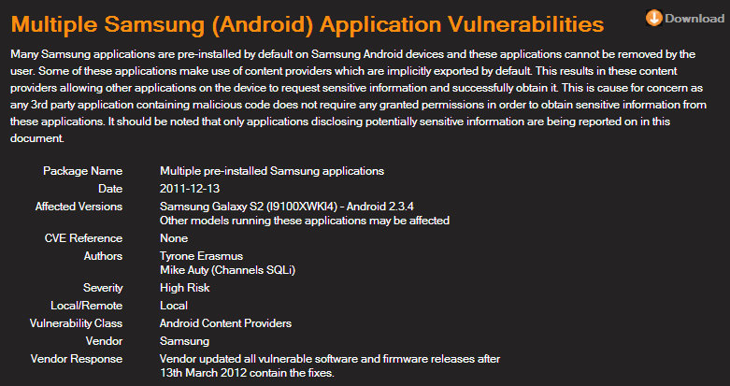
Coordinated Disclosure
http://labs.mwrinfosecurity.com/advisories/2012/09/07/multiple-samsung-android-application-vulnerabilities/
Notes:
An example of coordinated disclosure
About 3 months, not bad but could be better

Slide 32
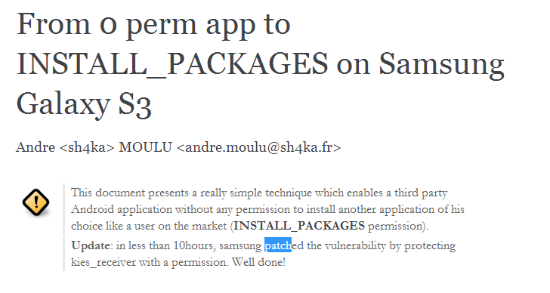
Full Disclosure
http://sh4ka.fr/android/galaxys3/from_0perm_to_INSTALL_PACKAGES_on_galaxy_S3.html
Notes:
10 Hours! WOW!!! Nice job Samsung!

Slide 33
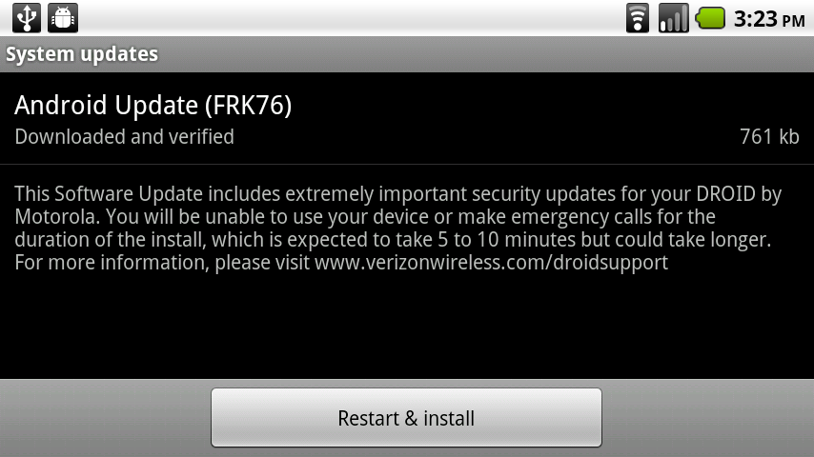
Partial Disclosure: VZW
Notes:
This is a screenshot from an old school Droid… They say there are important security fixes, but they don’t tell you what they are.

Slide 34
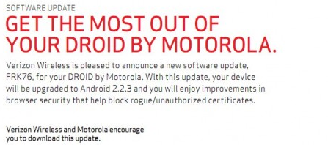
Partial Disclosure: VZW
Notes:
Here is some “more information”, but still they don’t supply CVEs. Besides, I’d hardly call this a disclosure.
The security community would really like to track this stuff in much more detail than this.

Slide 35
Non-disclosure?
VFAT Linux kernel bug (CVE-2013-1773)
Reported by G13 to Android Security Team in Dec 2011
Not much in the way of coordination
After doing a root cause analysis, I reported it to OSS-SEC mailing list, spawning huge thread
Apparently the AST didn’t even report it upstream
Still no comment from the AST…

Slide 36
Attack Surface
Like an ocean…

Slide 37
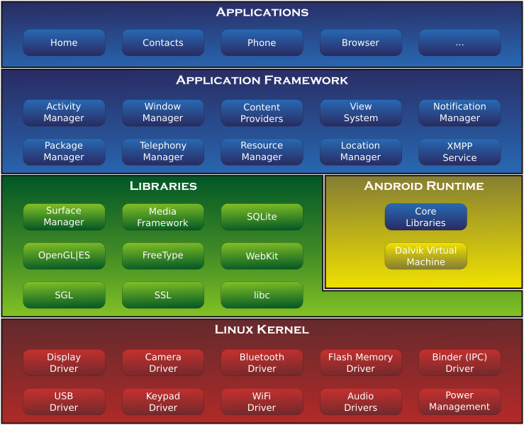
System Architecture
Notes:
This is the most widely used architecture diagram for Android. People always use it because it shows a ton of important Android-specific stuff.
The stuff in blue is all Dalvik code, the source is in Java…
The stuff in yellow makes it possible to run the stuff in blue.
The stuff in green are libraries written in native code.
This provides the most interesting attack surface for remote memory corruptions.
It also includes the libc, called Bionic, which contains important stuff like the heap the implementation.
There are also various JNI libraries in addition to the common system libraries shown here.
The stuff in red is all kernel land. This stuff is great for escalating privileges once you get on a device.
Overall, you can see the system architecture is pretty complex.
Many operations in the system go all the way from Dalvik code, down into the kernel, and then all the way back to Dalvik code in another process.

Slide 38
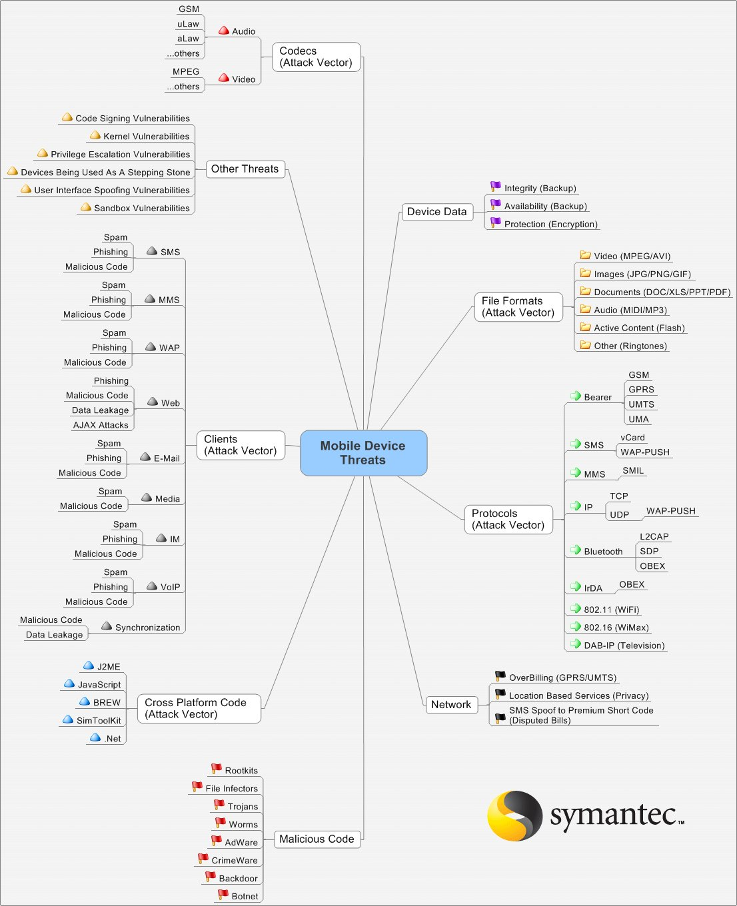
http://recxltd.blogspot.com/2012/02/reflecting-on-mobile-security-today.html
http://ddanchev.blogspot.com/2007/03/complexity-and-threats-mind-mapping.html
http://www.symantec.com/connect/blogs/picture-worth-thousand-words-and-i-only-have-type-300
Notes:
I apologize if you cant see this diagram very well. Hopefully you can see it well enough to get the gist of it…

Slide 39
Attack Surface Size
The attack surface has grown since that diagram was created
The attack surface is HUGE
Especially “client-side” user-initiated stuff
Too big to cover by itself in a one hour talk
Lots of pushing and polling going on

Slide 40
Tools

Slide 41


Slide 42
Custom BusyBox
Why?
Single binary
Others?
toolbox
motobox
various busybox cross-compiles

Slide 43
Custom BusyBox
Existing binaries have bugs
Issues mapping uid and gid to name
Issues mapping sockets connections
lsof
netstat
Will be working to address these issues REAL SOON NOWTM

Slide 44
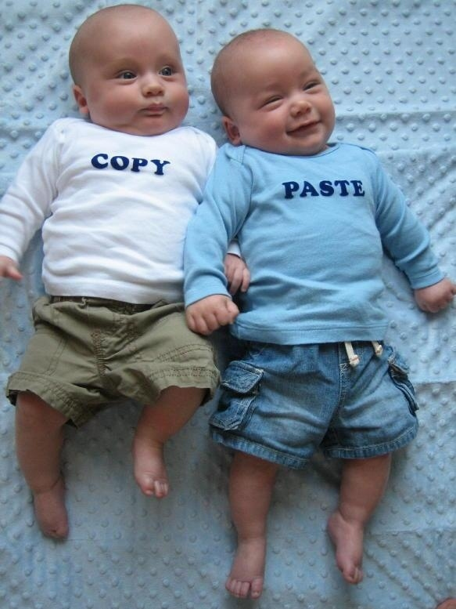
Source Code
There is A LOT of it.
AOSP
Hardcore forking action
Lots of community “ROMs”
Kernel sources by OEMs
CONFIG_MODULES=y
Can build your own modules!
“insmod” on devices!!
http://www.blogsaays.com/wp-content/uploads/2012/04/copy-paste-material.jpg

Slide 45

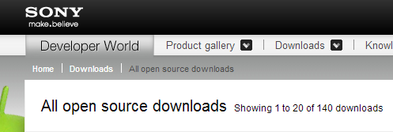
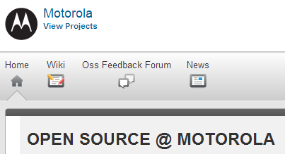


Source Code II
https://www.codeaurora.org/
http://developer.sonymobile.com/downloads/opensource/
http://sourceforge.net/motorola/
http://opensource.samsung.com/index.jsp
http://htcdev.com/devcenter/downloads
Notes:
There’s a lot of places to get kernel sources.
Any of these sources may have potential modifications.
Beware, these sources may or may not really be what was used to build the kernel for your device…
Consult the binaries if necessary.

Slide 46
Compilers
Many tool chains to choose from
SDK/NDK
AOSP “prebuilt”
Linaro
Official ARM compiler (RVCT)
Others?

Slide 47
Debuggers
Lot’s of different versions
Various NDK revisions
Various AOSP prebuilt binaries
Versions from Linux distros
Might have to try lots to find a working version :-/

Slide 48
Debugging: Issues
gdbserver will crash on you :-/
Need to investigate and fix these issues
Single-stepping nightmares
ARM vs Thumb insanity
x/i $pc|($cpsr&1)
Symbols can tell the debugger which mode

Slide 49
Debugging: Tips
What worked for me –
Using the AOSP prebuilt debugger
arm-eabi-gdb and gdbserver
Pulling all relevant binaries from the device
Built bins with symbols from AOSP

Slide 50
Debugging: Example Part I
ubvm:0:galaxynexus$ ls -l app_process lib*so linker
-rw------- 1 jdrake jdrake 9.7K May 6 02:21 app_process
lrwxrwxrwx 1 jdrake jdrake 26 Jun 1 23:54 libc.so -> symbols/system/lib/libc.so*
lrwxrwxrwx 1 jdrake jdrake 28 Jun 1 23:42 libdvm.so -> symbols/system/lib/libdvm.so*
lrwxrwxrwx 1 jdrake jdrake 31 Jun 26 22:19 libstdc++.so -> symbols/system/lib/libstdc++.so*
lrwxrwxrwx 1 jdrake jdrake 32 May 29 04:24 libwebcore.so -> symbols/system/lib/libwebcore.so*
-rw------- 1 jdrake jdrake 39K May 6 02:20 linker
Notes:
This is an example of my setup for remote debugging the browser.
The important parts are telling gdb where to find the binaries that you pull off the device.
In this case I was targeting the galaxy nexus, so I was able to build versions with symbols and use those for debugging.
I did not need to put them on the device, which is nice.

Slide 51
Debugging: Example Part II
ubvm:0:galaxynexus$ cat stuff.gdb
set solib-search-path .
set arm fallback-mode thumb
target remote 127.1:8080
[...]
set arm fallback-mode auto
cont
Notes:
In addition to setting up the binaries, have to also set the solib-search-path variable.
Also, the “arm fallback-mode” stuff is helpful. Without the correct mode, inserting breakpoints might cause crashes.

Slide 52
Debugging: Tips
With these two things together, you can get accurate source level debugging
\o/ WIN \o/
|| ||

Slide 53
Debugging: Tips
Possible improvements
Use on-device debugger from ARM Linux distro
Requires libc, etc
Probably faster than USB

Slide 54
Using IDA Pro
Open the binary
Select ARM processor and click “SET”
Click processor options
Click “Edit ARM architecture options”
Select ARMv7-A&R
Click OK, OK, OK
Reverse!
Notes:
Ugh this is an important one and was very confusing at first…

Slide 55

Exploitation
http://1.androidauthority.com/wp-content/uploads/2012/08/banner-best-army-military-soldier-games-android-120824.jpg

Slide 56
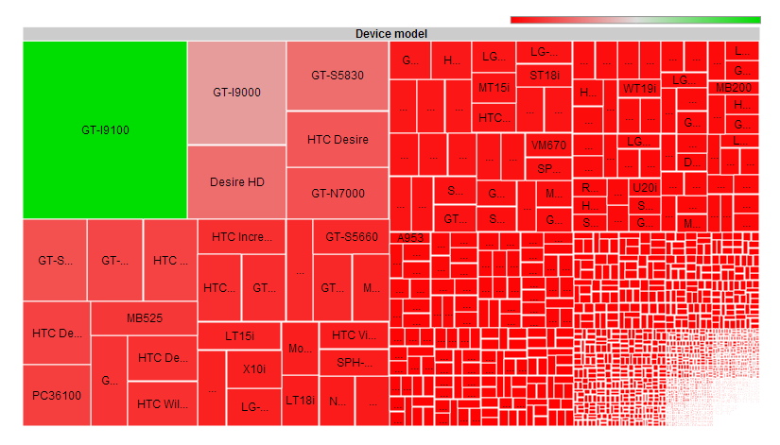
Tons of Devices
Notes:
There are tons of devices.
Every device is like a snowflake.

Slide 57
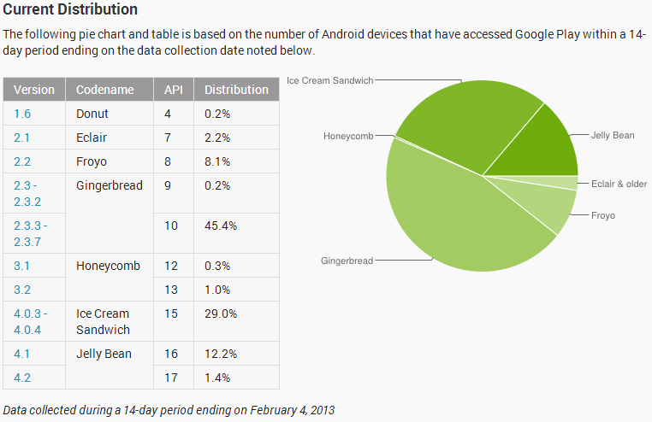
Device Pool by Android Version

Slide 58
Exploitation
Most exploitation details are architecture specific
Often device specific
ARM presents some challenges
Separate data & code cache
Multiple processor modes
ARM, Thumb, Thumb2, etc

Slide 59

Bionic Heap
Bionic (libc) uses dlmalloc
Supposedly somewhat hardened
Didn’t pose any challenge during recent exploit dev
Traditional unlink techniques should apply

Slide 60
Browser Heap
WebKit has “fastMalloc” but all memory is serviced by dlmalloc!
Includes “new” and “delete”
Crashes dereferencing 0xbbadbeef
Usually not interesting…
Out of memory

Slide 61
Dalvik ASLR Fail #1
Zygote (app_process)
Forks children, doesn’t use execve()
All Android Applications (Apps) share same initial memory layout
An info leak (from any App) is good until reboot at least, maybe longer…
The browser is an App!

Slide 62
Information Leaks
Subreption paper
“Android exploitation primers: lifting the veil on mobile oﬀensive security (Vol. I)”
Talks about using infoleaks to exploit the browser
Uses CVE-2010-4577 (Chris Rohlf’s WebKit CSS Type confusion)
Dynamic Return-oriented Programming
We are truly in the infoleak era, as evidenced by two exploits seen in the wild in the last month.

Slide 63
Hardening
Tempered Android.
http://1.androidauthority.com/wp-content/uploads/2012/08/banner-best-army-military-soldier-games-android-120824.jpg

Slide 64
Mitigations History
Version | Mitigation (s) Introduced
1.5 | Disabled %n format specifier
1.5 | Stack cookies (-fstack-protector)
1.5 | safe_iop
1.5 | dlmalloc enhancements
1.5 | calloc integer overflow check
2.3 | Non-executable stack
2.3 | Non-executable heap
2.3 | mmap_min_addr (enhanced in 4.1?)
2.3 | -Wformat-security -Werror=format-security
4.0 | Randomized stack
4.0 | Randomized mmap (libraries, anon mappings)
4.0.2 | Randomized heap
4.1 | Default umask changed to 077 Restricted READ_LOGS per app
4.1
4.1 | Randomized linker
4.1 | Read-only relocations (RELRO + BIND_NOW)
4.1 | Position independent executable (PIE)
4.1 | dmesg_restrict and kptr_restrict
Notes:
This is the history of various mitigation features.
I’m not going to go through these in depth, but the thing to see here is when things were introduced…
We’ll look at a couple of these a bit more..

Slide 65
Hardening: Jelly Bean 4.1
Logcat output hardening
Apps can only see their own log messages
Full ASLR, finally!
Well, almost..
http://blog.n0where.org/errata-to-avoiding-android-app-security-pitfa

Slide 66
Dalvik ASLR Fail #2
Linux-specific “personality” System Call
Dalvik VM uses ADDR_NO_RANDOMIZE :-/
Child processes don’t get randomized at all
Not the stack, not the heap, not the libraries, certainly not the binary base
Nothing is randomized

Slide 67
Dalvik ASLR Fail #2
Except….
Doesn’t work across set-uid executions
Why does this matter?
Makes exploiting child processes of Dalvik applications TRIVIAL, even remotely

Slide 68
Hardening: Jelly Bean 4.1
Umask changes
Umask is supposedly is 077, but not for adb…
Here be dragons, take care.
dq:0:~$ adb shell
shell@android:/ $ getprop ro.build.fingerprint
google/takju/maguro:4.1.1/JRO03C/398337:user/release-keys
shell@android:/ $ umask
000
shell@android:/ $ exit
Notes:
I tried to get the umask of all processes on the device, but it unfortunately isn’t exposed via procfs.
Would need to inject a call to umask() into every process to find out…
Instead, I looked at the AOSP code.

Slide 69
Hardening: Jelly Bean 4.2
Content Provider default access changes
Now assumed to be “not exported”
New SecureRandom implementation
Old method was deterministic !
JavascriptInterface method annotation
Prevents abusing app methods sloppily exposed to Javascript

Slide 70
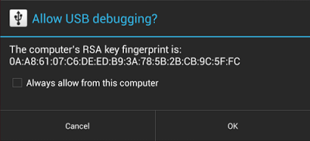
Hardening: Jelly Bean 4.2.2
In 4.2.2, Google enabled ADB authentication!
Addresses attacks against devices with USB debugging enabled
Hi Kos!

Slide 71
Hardening: ADB
Many devices ship w/o ALLOW_ADBD_ROOT
adbd will ignore ro.secure / ro.kernel.qemu system properties
1156 #if !ADB_HOST
1157 static int should_drop_privileges() {
1158 #ifndef ALLOW_ADBD_ROOT
1159 return 1;
1160 #else /* ALLOW_ADBD_ROOT */

Slide 72
Chrome for Android
Chrome for Android includes updated WebKit
Requires 4.0+
NEW! A beta channel too!
Allows updating their WebKit via Google Play
Without OTA firmware updates
Without involving carriers and OEMs

Slide 73
Chrome for Android
Chrome for Android has some “sandboxing”
Not really, mostly just process separation
More to do here
Probably actively being worked on…
Caveat: System WebKit remains exposed to advertising, twitter, apps that use WebViews

Slide 74
Future Mitigations
SEAndroid
SELinux for Android
seccomp sandbox! (Issue #166704)
Kernel hardening (PXN, UDEREF, etc)
SAFEDROID from Subreption
FORTIFY_SOURCE
Future looks promising / challenging!
https://code.google.com/p/chromium/issues/detail?id=166704

Slide 75
Conclusions / Recommendations

Slide 76
Recommendations to Users
Use Nexus™ devices if possible
Pure google, faster updates
Always use the latest version
Use Chrome for Android!
Buy devices up-front
Don’t sign up for 2 year contracts
Send a message to carriers!

Slide 77
Recommendations to Carriers/OEMs
Improve communications
Provide proper and detailed disclosures w/ updates
Tell which updates are in progress
Be more transparent
Explain WHY people aren’t getting updates
Communicate your difficulties

Slide 78
Recommendations to Carriers
Put your customer’s needs first!
Stop bloating things!
Get updates to users faster
Possibly an opt-in beta program?
Support devices at least as long as the contract!!!

Slide 79
Recommendations to OEMs
Put your customer’s needs first!
Release more security updates
Release security fixes faster
Offer updates outside of carriers?
Stop making so many changes!

Slide 80
Recommendations to OEMs II
Provide open source using source code repositories!
These kernel tar-balls are unwieldy and entirely wasteful
Commit information lets researchers make sense of things

Slide 81
Recommendations to Google
Google
Continue improving security (CTS ftw)
Release more security updates!
Personal requests (one can hope)
More devices with a qwerty keyboard ☺
Oh, and send me Google Glass! ;-)

Slide 82
Recommendations to Researchers
Do your own disclosure
Do it on your own timeline
Release your own advisory
Don’t bet on the vendors saying anything or giving you credit
Join me in researching Android security ☺

Slide 83
Conclusions
Device pool is a mess
Nobody is getting timely patches
Researching Android security is challenging!
Many tools are half broken
But the situation is getting better all the time…
Android Security is maturing, very slowly.

Slide 84


QUESTIONS?
Contact information:
@jduck1337
“jduck” on IRC
Email: jdrake [circled-a] accuvant.com
#droidsec on freenode
Keep an eye on my github ;-)
Book in progress!

Slide 85
BONUS SLIDES

Slide 86
SAFEDROID
Subreption guys working on a hardened Android build
Focused on OMAP (Galaxy Nexus, others)
Heavily modified version of PaX
Improved exploit mitigations
Replace dlmalloc with hardened jemalloc
Kernel heap hardening
Notes:
Should be interesting to see the output of this!
Especially if Google, Carriers, or OEMs actually pick up the changes…

Slide 87
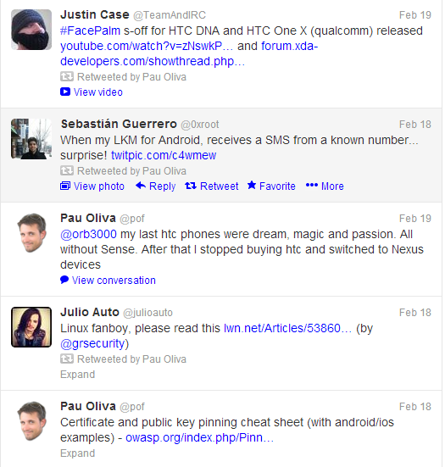
Up-to-date tools info
Follow @pof for great tweets about Android tools!
Watch who he re-tweets for more great people to follow.

Slide 88
Dalvik ASLR Fail #2
commit 311886c6c6fcd3b531531f592d56caab5e2a259c
Author: Selim Gurun <sgurun@google.com>
Date: Fri Jan 13 10:47:15 2012 -0800
Prevent memory fragmentation.
Bug: 5817320
Prevent memory fragmentation and potential allocation failures. This
change is temporary.
Change-Id: Id1e8f9606687648235ea9e18861125a8c799d812
…

Slide 89
Dalvik ASLR Fail #2
diff --git a/vm/native/dalvik_system_Zygote.cpp b/vm/native/dalvik_system_Zygote.cpp
index 31fecfd..2d66cef 100644
--- a/vm/native/dalvik_system_Zygote.cpp
+++ b/vm/native/dalvik_system_Zygote.cpp
@@ -446,6 +447,12 @@ static pid_t forkAndSpecializeCommon(const u4* args, bool isSystemServer)
dvmAbort();
}
+ int current = personality(0xffffFFFF);
+ int success = personality((ADDR_NO_RANDOMIZE | current));
+ if (success == -1) {
+ LOGW("Personality switch failed. current=%d error=%d\n", current, errno);
+ }

Slide 90
Hardening: Umask
commit 6ebf12fe1bc2de7af4522349973e8bfcc71d6126
Author: Nick Kralevich <nnk@google.com>
Date: Mon Mar 26 09:09:11 2012 -0700
init: Change umask of forked processes to 077
[…]
ueventd: Keep umask at 000. uevent needs to be able to
create device nodes with exactly the permissions it
indicates.
[…]
commit eb68fa8153d97f5f8b6d9062fcf91fe393e3bff3
Author: Nick Kralevich <nnk@google.com>
Date: Mon Apr 2 13:00:35 2012 -0700
adb: set umask to 000
Notes:
Looking at AOSP, I found that the changes happened in Android’s “init” code.
“init” is the first process in the system, started by the kernel, so these changes affect all procesess.
“ueventd” and “adbd” were both modified to set their umask back to zero.
The commit logs say these processes need to be able to create files with explicit permissions.
I would think that would be possible regardless of umask, but I’m not intimately familiar with the code…
Regardless, it would probably would require more changes that way, which takes more effort, more testing, etc

